Slide 1
Group 28 Project – 5 ENPM661 Planning for Autonomous Robots
Presented By : Chayan Kumar Patodi Prasanna Marudhu Balasubramanian

Slide 2
Title: Optimal Path Planning for Autonomous Delivery Robots
Option 1 – Implementing the cutting edge technique from literature in Simulation
Abstract :
The determination of collision free path for the robot to navigate between start position and goal position through obstacles cluttered workspace is the centre of focus for an autonomous robot mobility.
There are different type of algorithm available for path planning of these robots including A-Star, Dijkstra, RRT etc..
In this project, we compare the time complexity and time efficiency to find an optimal planning algorithm for the Delivery robots.
To complete the navigation task, the algorithms will read the map of the environment or workspace and subsequently attempts to create free paths for the robot to traverse in the workspace without colliding with objects and obstacles.

Slide 3
Motivation/Scope of Project
The primary focus on designing the algorithm of mobile delivery robot should be the time complexity in reaching the goal position.
The correct and suitable algorithms will fulfil its function fast enough to find an optimal path for the robot to traverse in the space, even if there are a large number of obstacles scattered throughout in a complex environment.
The outcome of this project is that it determines the best suitable path planning algorithm to carry out the tasks in the time critical mission.

Slide 4
Methodology:
The time of execution of all the mentioned algorithm for the obstacle map is determined and the also the final obtained path length is compared between these algorithms.
The method is repeated for different goal points and start points and the corresponding time and path length are measured and compared.
Also the method is analyzed for simultaneous multiple goal points in the same Map environment. The results are compared in this scenario.
The final results will be tabulated and simulation outputs will be presented.

Slide 5
Path Planning Algorithms.
Dijkstra Algorithm.
A-Star(A*) Algorithm.
BFS algorithm.
RRT.
Visibility Graph.
RRT*.
Weighted A-Star

Slide 6
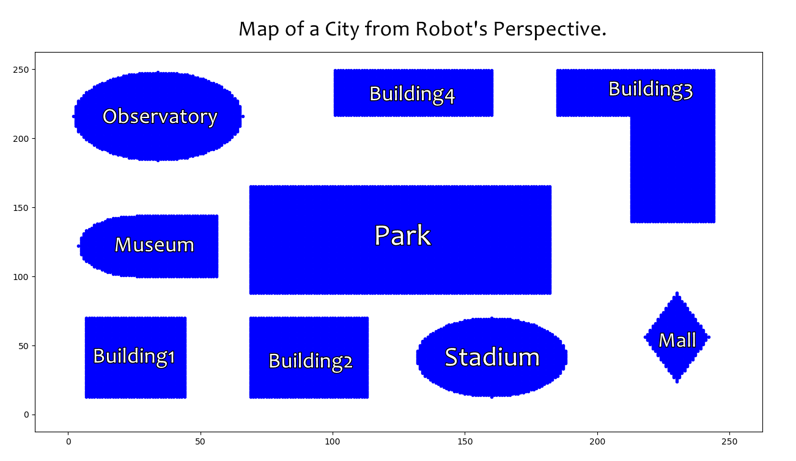

Slide 7
Algorithms:
BFS is a traversing algorithm where you start traversing from a selected node and traverse the graph layer wise and thus exploring the neighbor nodes which are directly connected to the source node. We then move towards the next level neighbor nodes. We move horizontally and visit all the nodes of the current layer.
Dijkstra Algorithm is an algorithm we can use to find the shortest distances / minimum costs depending on what is represented in the graph. We are working backwards from end to the beginning , finding the shortest path each time.

Slide 8
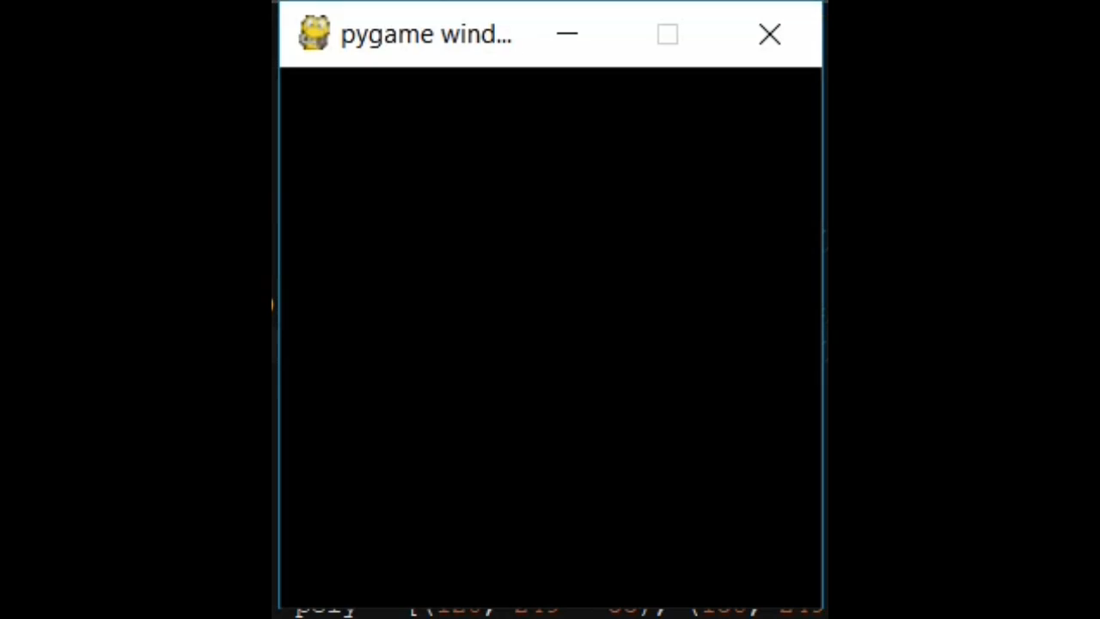

BFS Algorithm
Dijkstra Algorithm

Slide 9
Algorithms:
A-star algorithm augments the Dijkstra’s algorithm by adding in the heuristic , so that the algorithm doesn’t waste time exploring the directions which look less promising. The heuristic used in A star estimates the distance from a given point to the destination.
Weighted A* is a modified version of A* algorithm where the weight factor is included
In Visibility Graph each node in the graph represents a point location and each edge represents a visible connection between them.
The shortest path between two obstacles follows a straight line except at
the vertices of the obstacle

Slide 10
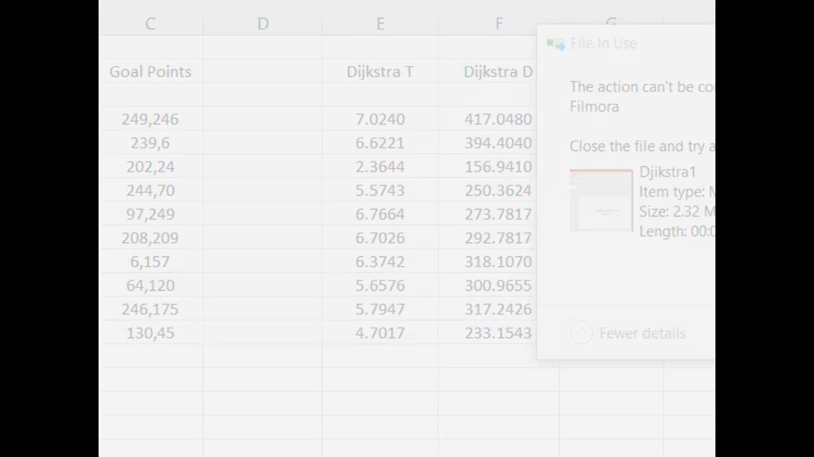
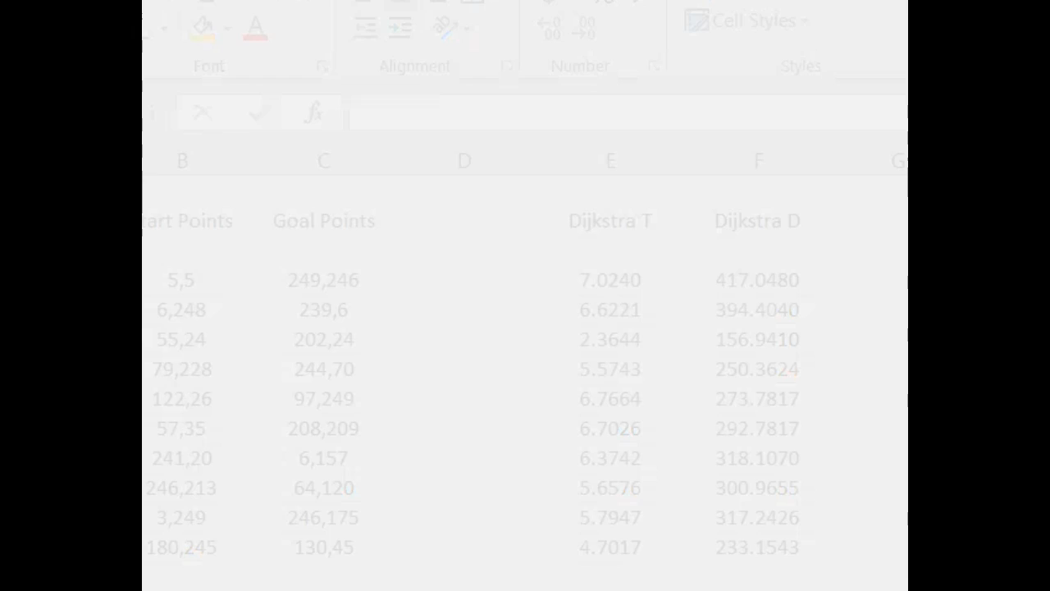
A-Star
Weighted A-Star

Slide 11
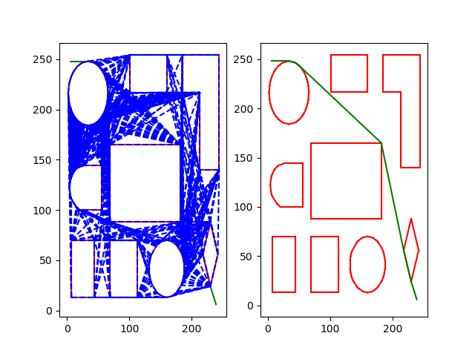
Visibility Graph :

Slide 12
Algorithms:
In RRT points are randomly generated and ver connected to the closest available node. Each time a vertex is created considering that the vertex lies outside of an obstacle and the vertex is made to its closest neighbor . The algorithm ends when a node is generated within the goal region, or a limit is hit.
RRT* considers the cost from the parent node, priority is given to the cheaper cost node than the proximal node.

Slide 13
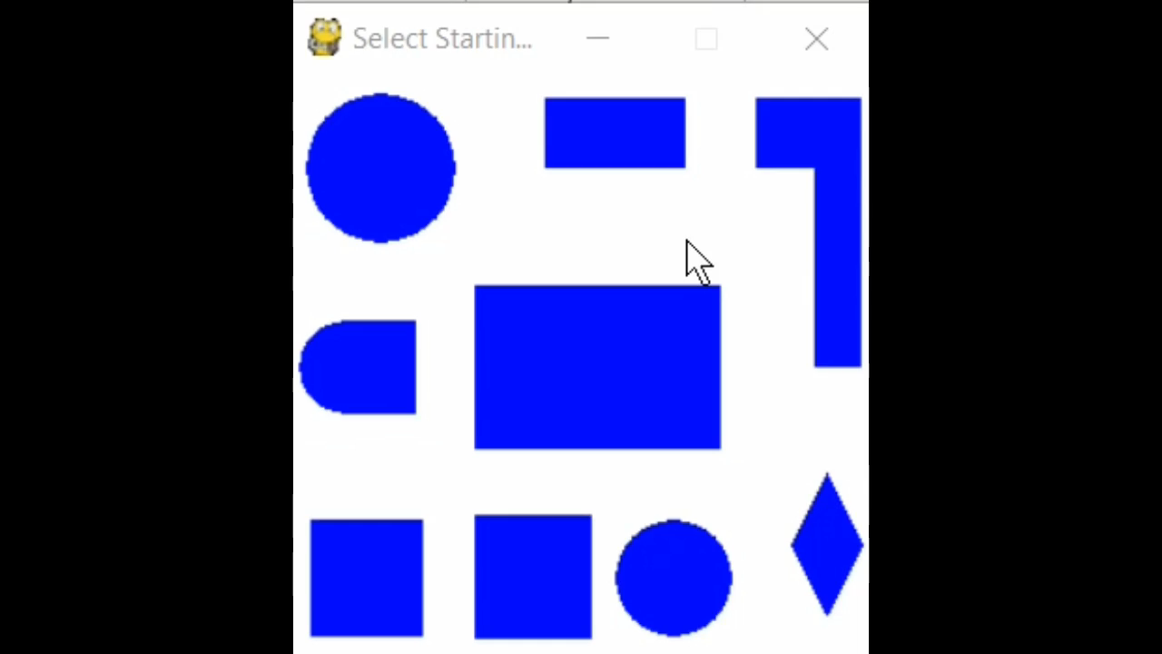
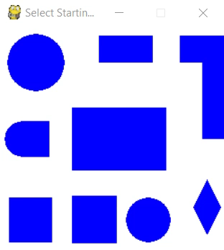
RRT
RRT-Star

Slide 14
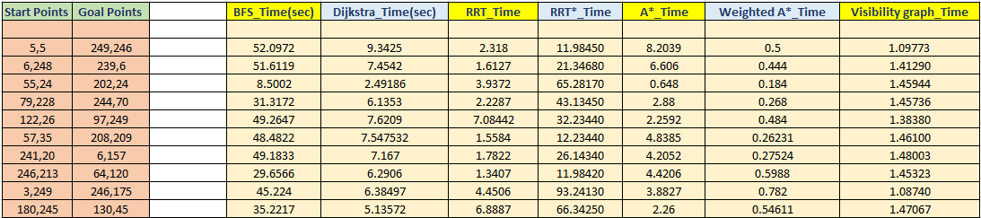
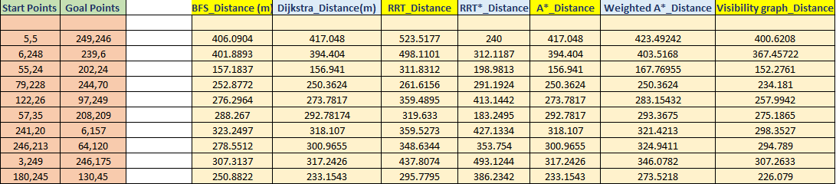
Results:

Slide 15
Inference :
RRT and RRT* finds the optimal path but its node exploration is very random and is not reliable.
Visibility graph needs the predefined obstacles in order to form the vertices to explore the space.
We compare the rest 4 algorithms , on the basis of time taken for execution and path length.
If we want better execution time , we will go for Weighted A-star , whereas for the shortest distance we can go for Dijkstra and A-Star.
Depending on the type of application , we can decide which parameter is more important to us and we can decide a tradeoff between the factors used for comparison.

Slide 16
Previous Researches:
“Comparative Study of Different Path Planning Algorithms: A Water based Rescue System” by ‘S. M. Masudur Rahman Al-Arif’
-- The time complexity and shortest path is been compared between only three algorithms.
2. “The Comparison of Path Planning Algorithms for Omni-Directional Robots in Dynamic Environments” by ‘Felipe Haro and Miguel Torres’
– This paper analyze and compare three path planning methods for omni-directional robots, which are based on a) the Bug algorithm b) the Potential Fields algorithm, and c) the A* algorithm
3. “A comparison of homotopic path planning algorithms for robotic applications” by ‘Emili Hernandes’
-- This paper compares algorithms RRT and A* for underwater navigation by autonomous vehicles
“Path planning algorithms for an autonomous mobile robot” by ‘Milena Karova’
-- The Dijkstra and A* path planning algorithm are compared in this paper.
“Path planning of autonomous mobile robots: A survey and comparison” by ‘Pradeep Jayabala’
--Graph Searching, Potential Field and Vector Field algorithm are considered in this paper

Slide 17
Future Work
1) This study can be extended for one start point and multiple goal points.
2) More algorithms can be compared with the existing ones.
3) Certain algorithms can be combined with parameters such as heuristic costs, to make existing algorithms more robust.
4) In future we can consider for dynamic obstacles and uncertainties for better analysis.
5) In Weighted A* and A* the Euclidean method is used in heuristic function and it can be checked with the other method and it may yield a better result.

Slide 18
Thank You

